Slide 1
NodeMCu to Azure
By leolau

Slide 2
Content
Install NodeMcu board manager
Install library
Fix the AzureIOTHub bug
Overview of the code
About MCP3008

Slide 3
Software needed
Arduino IDE (1.8.13) (I use portable version) https://www.arduino.cc/en/Main/Software
Ch340 driver https://sparks.gogo.co.nz/ch340.html

Slide 4
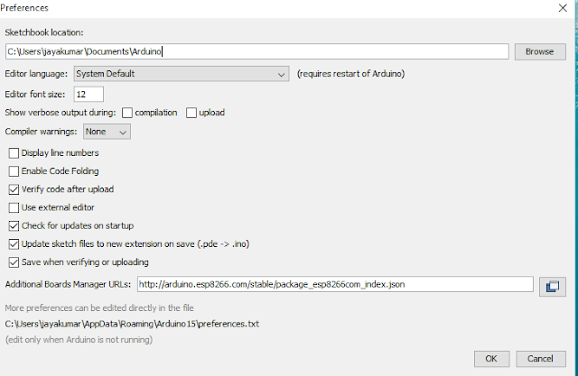
Installation of board manager for nodemcu
Go to Files→Preference
copy the below link in the Additional boards Manager http://arduino.esp8266.com/stable/package_esp8266com_index.json

Slide 5
If the following error comes up
Skipping contributed index file C:\Users\xxxxx\AppData\Local\Arduino15\package_esp8266com_index.json, parsing error occured: com.fasterxml.jackson.core.JsonParseException: Unexpected character ('<' (code 60)): expected a valid value (number, String, array, object, 'true', 'false' or 'null') at [Source: (FileInputStream); line: 1, column: 2]
based on the issues on github https://github.com/esp8266/Arduino/issues/6068 use the below link in preference
https://arduino.esp8266.com/stable/package_esp8266com_index.json

Slide 6
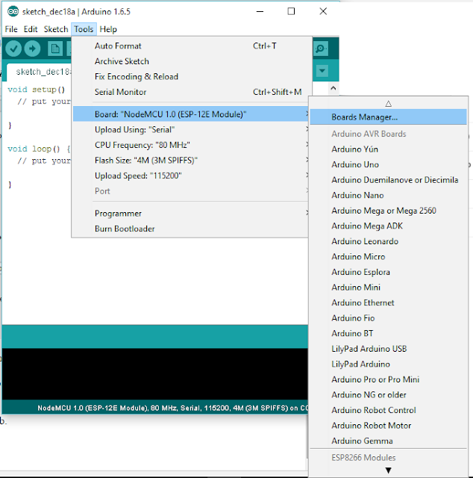
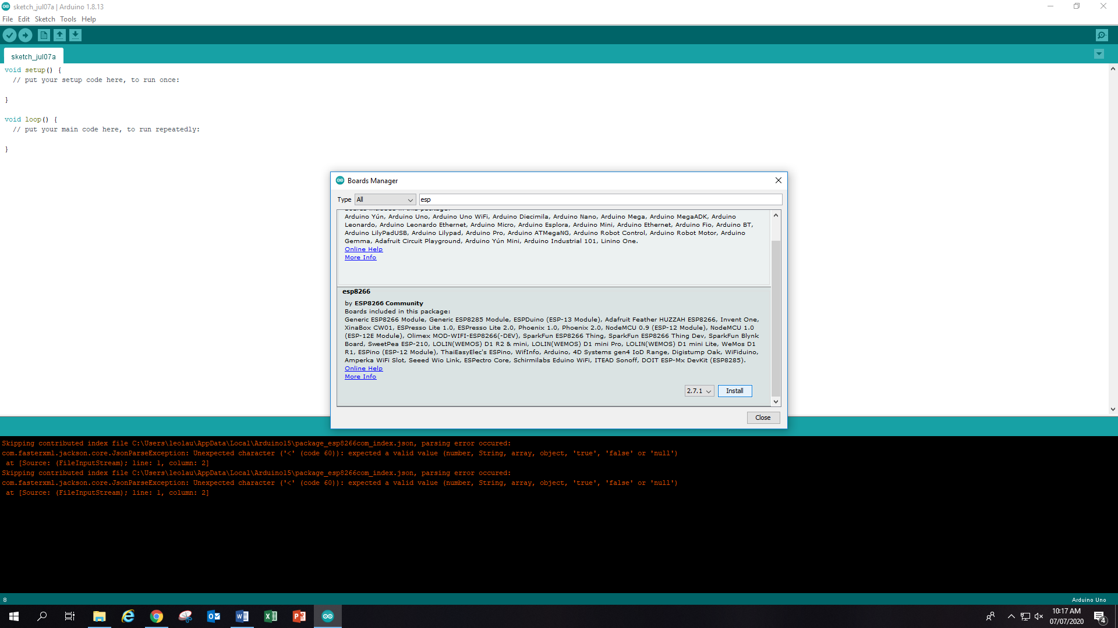
Board Manager to install esp8266

Slide 7
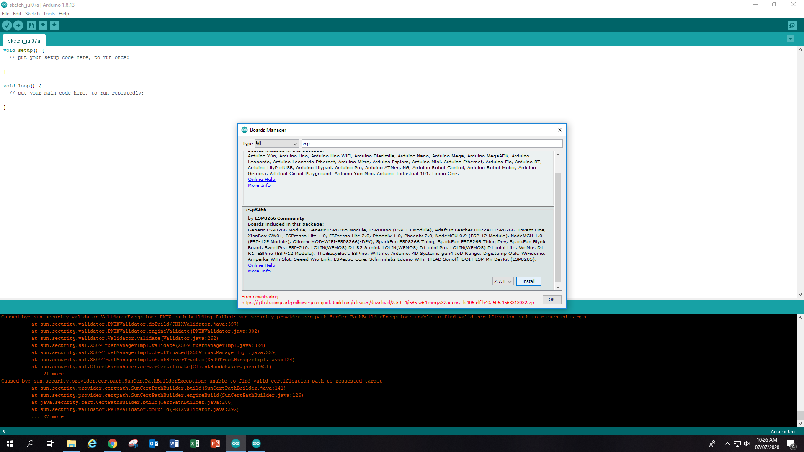
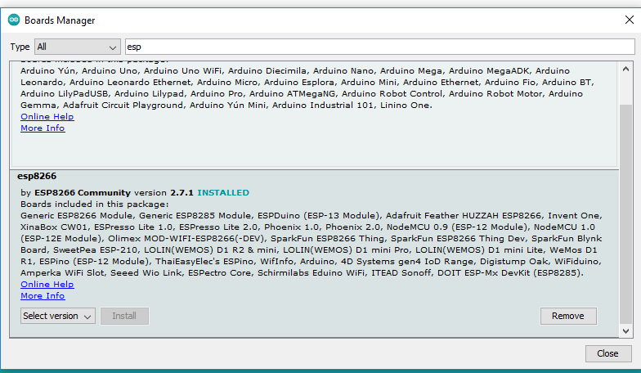
During installation
You might not installed all 4 parts at once. Make sure you click on “install” again it this happened until “installed”

Slide 8
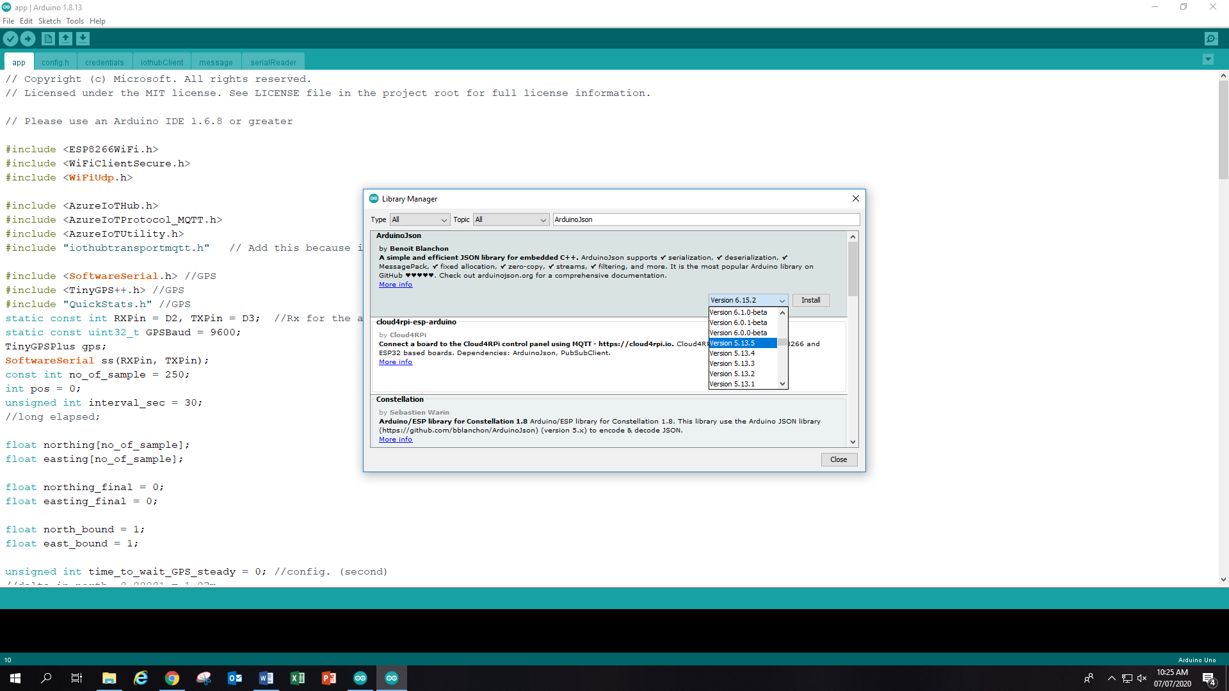
Library needed
Install the following libraries from Sketch -> Include library -> Manage libraries
AzureIoTHub (mine is version 1.3.8) by Microsoft
AzureIoTUtility (mine is version 1.3.8) by Microsoft
AzureIoTProtocol_MQTT (mine is version 1.3.8) by Microsoft
ArduinoJson (use version 5.1.3) Don't use version 6.x.x because some function is not available in this version
Adafruit_MCP3008 (if you are using MCP3008) by Adafruit
TinyGPS++ (installed through directly move the library to Library) https://github.com/mikalhart/TinyGPSPlus/releases
Quickstats.h https://github.com/dndubins/QuickStats
compile until all required library is installed

Slide 9
Here is the most xxxxed part
Please read the source of AzureIOTHub library Git issues https://github.com/Azure/azure-iot-arduino

Slide 10
process
If you do not do the following steps, you will not be able to compile and give the following error
C:\Users\<your_user_name>\Documents\Arduino\libraries\AzureIoTHub\src\iothub_client_ll_uploadtoblob.c:26:27: fatal error: internal/blob.h: No such file or directory #include "internal/blob.h" ^ compilation terminated. exit status 1 Error compiling for board NodeMCU 1.0 (ESP-12E Module).
exec: "{runtime.tools.python.path}/python": file does not exist Error compiling for board NodeMCU 1.0 (ESP-12E Module).

Slide 11
To fix this…
Navigate to C:\Users\your_user_name\AppData\Local\Arduino15\packages\esp8266\hardware
Locate the board's Arduino.h (hardware/esp8266//cores/esp8266/) and comment out the line containing #define round(x), around line 137. (wordPad/ Visustudio to open it)

Slide 12
About the python error
“Microsoft developers don't seem to have taken the time to understand the basics of how the Arduino IDE works. They could have easily avoided this problem of incompatibility with future versions of the ESP8266 Core for Arduino.” by pert
There are an issues on Github. But I don’t get it https://github.com/esp8266/Arduino/issues/5881
Later I follow the master to do the following simple step to fix this https://forum.arduino.cc/index.php?topic=663500.0
Open a txt file called platform.local.txt at two folders up from the Arduino.h step above
Add the following sentence and save it build.extra_flags=-DESP8266 -DDONT_USE_UPLOADTOBLOB -DUSE_BALTIMORE_CERT

Slide 13
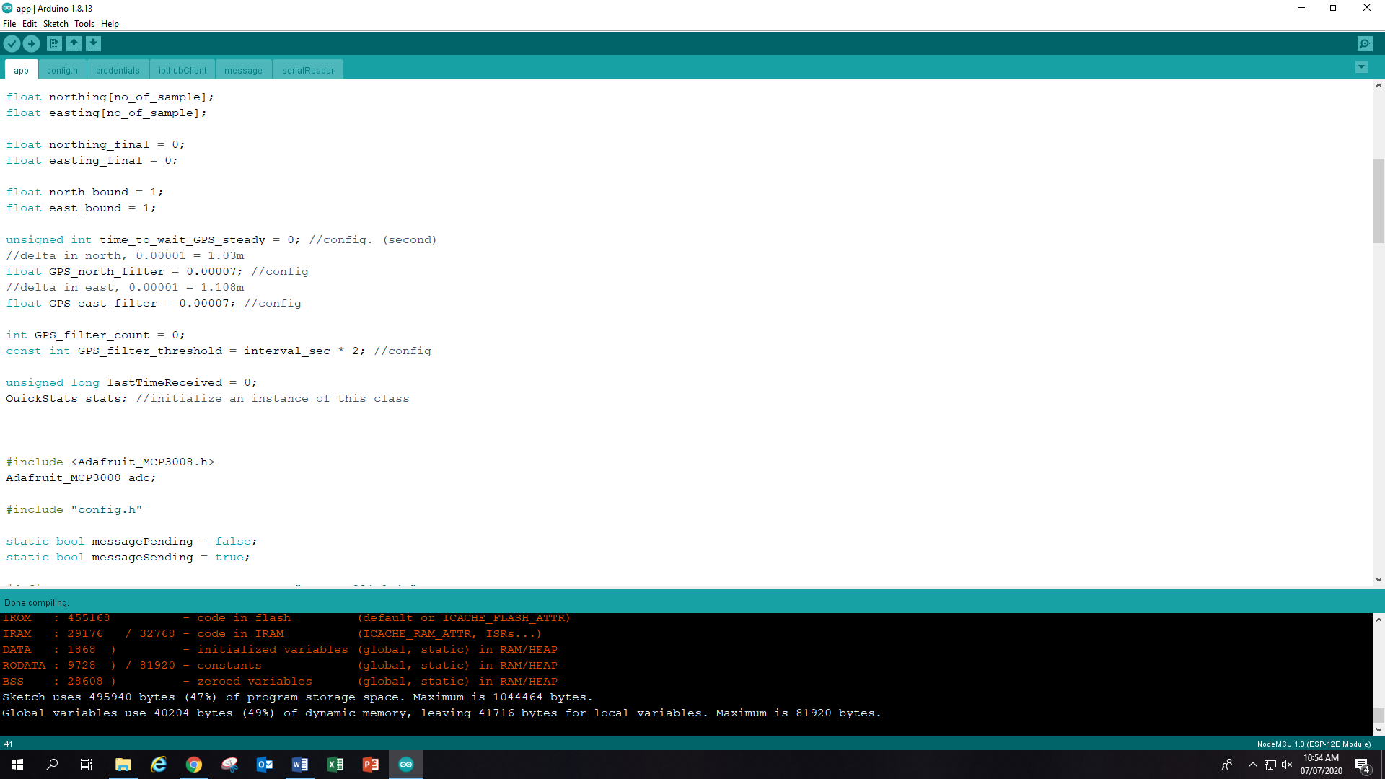
Compile again

Slide 14
Overview of the code

Slide 15
overview
There are 4 documents that is necessary for it to work
App.h is the main programe
Config.h is to let user to set their own parameter like the pin use for led
iotHubClient.io is the library for the app.h to call. No need to change anythings here
Message.ino is the script that run analogRead and assemble the message into JSON format

Slide 16
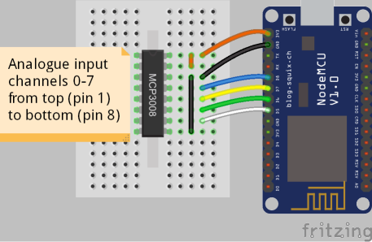
App.h
Set wifi ssid, wifi password, connection string from Azure here
Also, if you want, you can set the SPI pin for mcp3008 and GPS TX RX pin here

Slide 17
Message.ino
Set your analogRead or digitalRead here
Set the Json format of the message here

Slide 18
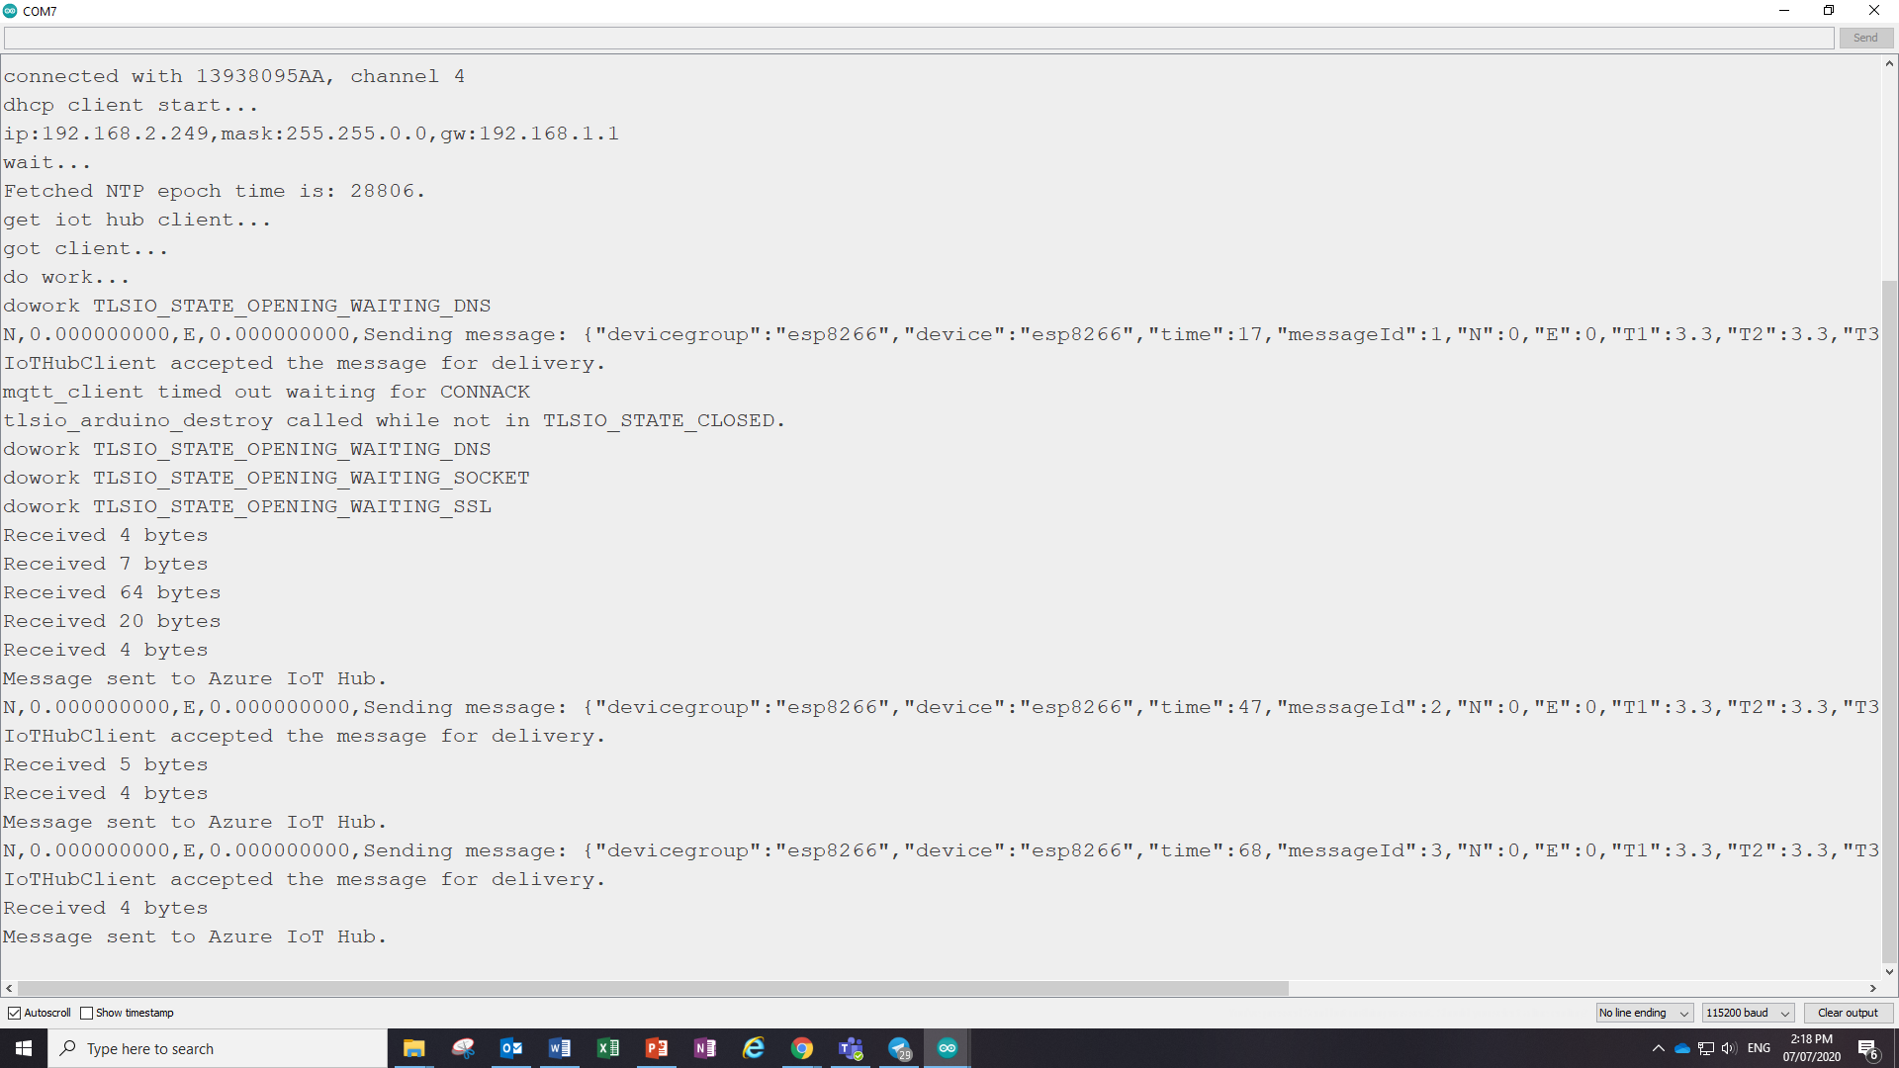
Sample of successful message

Slide 19
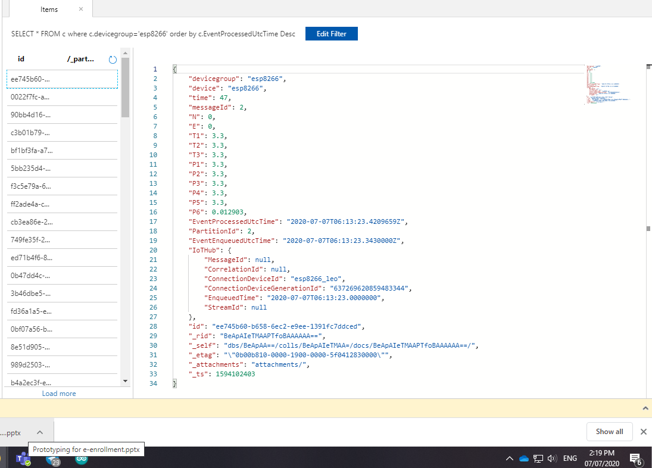
Sample of successful Azure Cosmo reading
The eventProcessUTCTime is the time message sent
Add 8 hours to the time to be the actual time in Hong Kong

